Slide 1


Introduction to Git and GitHub
Git is a powerful version control system, allowing you to track changes in your code and collaborate with others. GitHub is a platform for hosting and managing Git repositories, providing a collaborative environment for developers.
by farheen khan

Slide 2
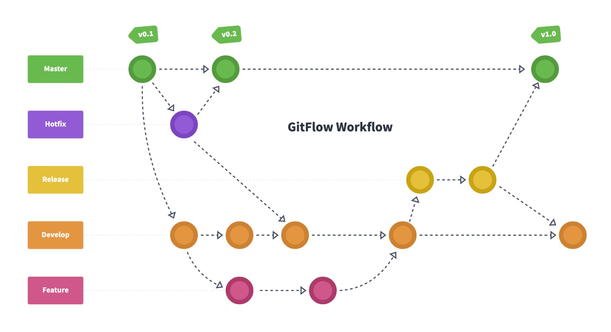
GitHub process diagram

Slide 3

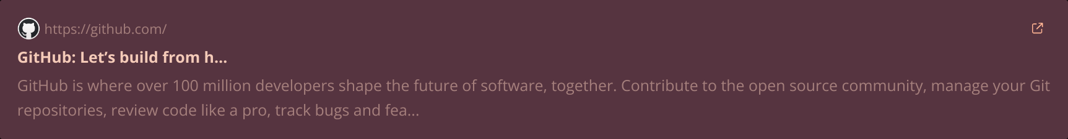
1. Git install link:-
2. Github link:-

Slide 4
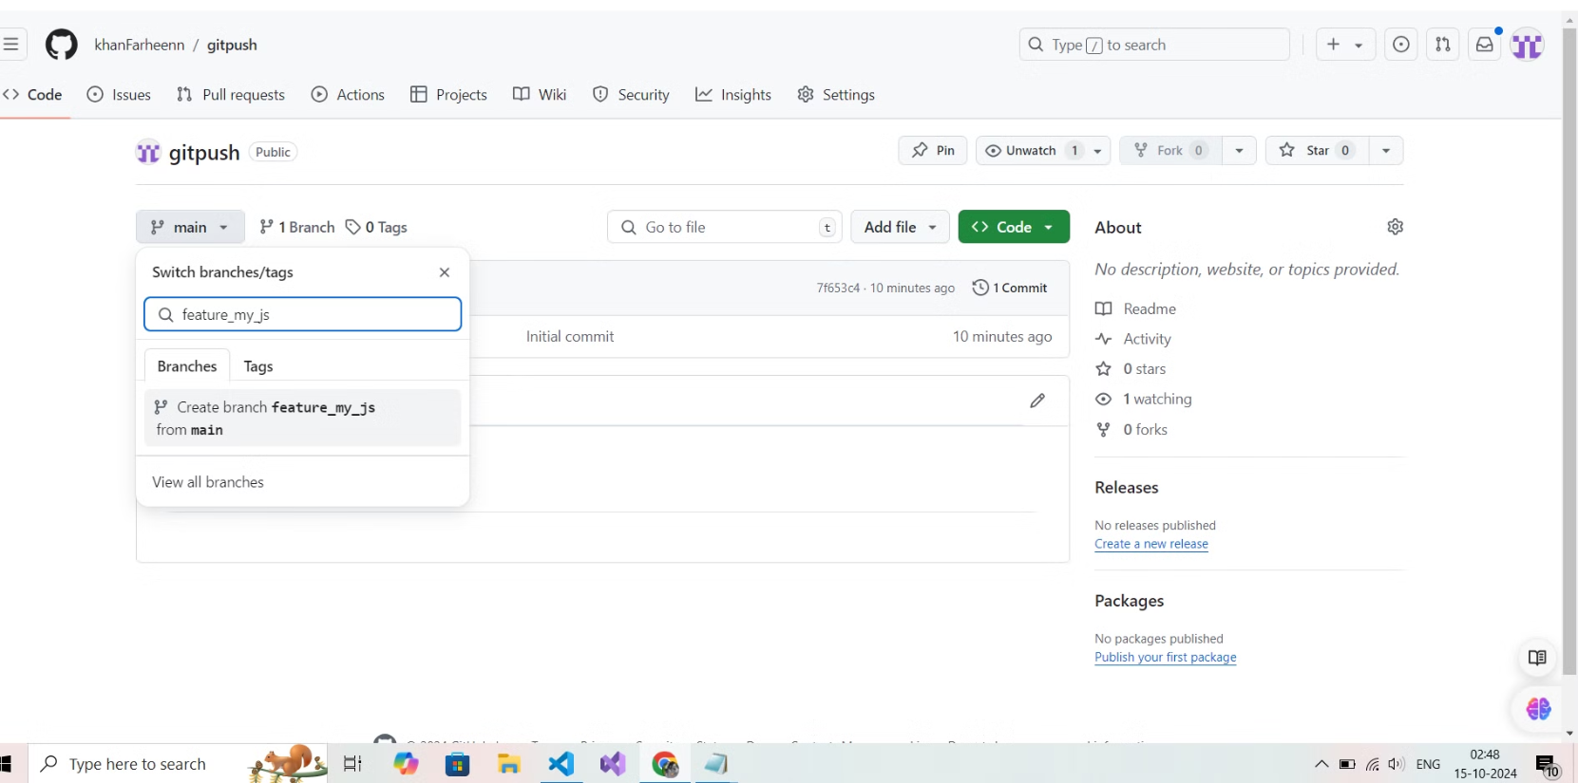
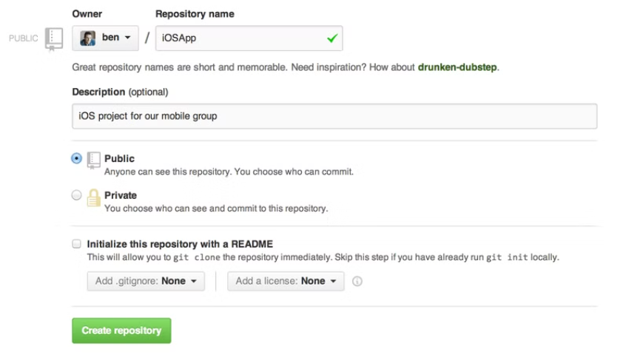
How to create Repository in github

Slide 5
How to create branch in github

Slide 6
Command :-
echo "# gitteach" >> README.md
git init
git add README.md
git commit -m "first commit"
git branch -M main
git remote add origin https://github.com/khanFarheenn/gitteach.git
git push -u origin main
git remote add origin https://github.com/khanFarheenn/gitteach.git
git branch -M main
git push -u origin main

Slide 7

What is Git?
Git helps track changes in your code over time, like a history of your project.
1
Version Control
2
Branching
Git lets you go back to older versions of your code, so you always have access to previous project states.
You can create branches to work on different parts of your project at the same time, without messing up the main code. Git lets you combine these branches later.
3
Collaboration
Git makes working together easy because it lets multiple people work on the same project, merge their changes, and fix any problems that might come up.

Slide 8

Git Repositories and Branches
A Git repository is a directory containing all your project files and the Git metadata that tracks their changes. Branches are independent lines of development within a repository, allowing you to work on different features or versions simultaneously.
1
Repository Creation
Start by creating a new Git repository for your project, initializing it with the `git init` command.
2
Branching
Use the `git branch` command to create new branches. Switch between branches using `git checkout`.
3
Merging
Once your work on a branch is complete, merge it back into the main branch using `git merge`.

Slide 9
Committing Changes with Git
Committing changes is the process of saving your work and creating a snapshot of the state of your project. Git allows you to create a detailed history of your work.
Staging Changes
Committing
Commit Messages
Use the `git add` command to stage the files you want to include in your next commit. This indicates which changes will be part of the commit.
Use the `git commit` command to create a commit, which captures the staged changes and saves them in your repository.
Write descriptive commit messages to explain the changes made in each commit, making it easier to understand the history of your project.

Slide 10
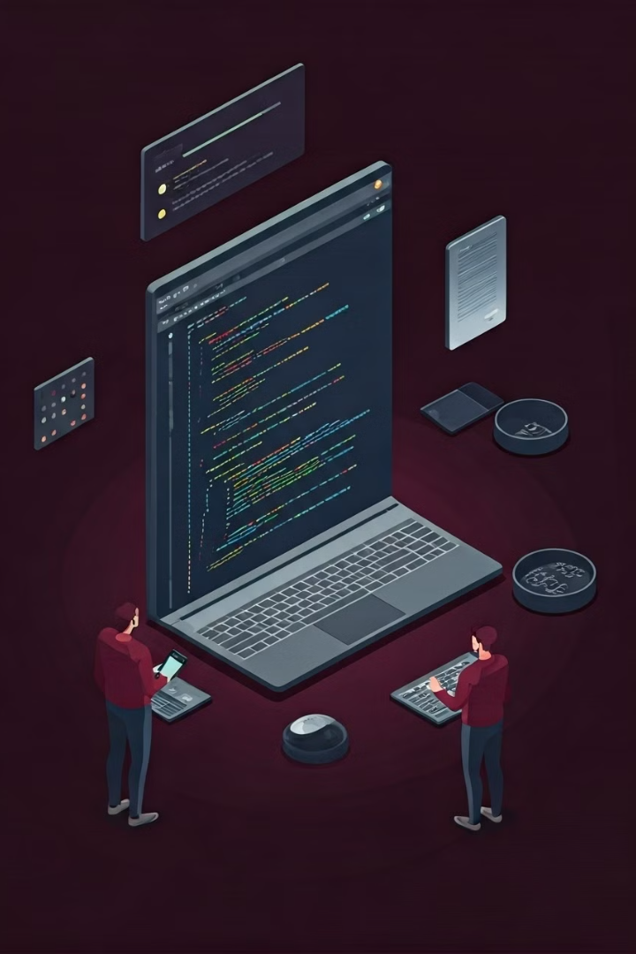



Collaborating on GitHub
GitHub provides a platform for hosting and managing Git repositories, enabling seamless collaboration between developers.
Forking Repositories
Create a copy of a repository on your own GitHub account to contribute independently.
Pull Requests
Propose changes to the original repository by submitting a pull request, allowing the original project owner to review your changes before merging.
Issues and Discussions
Use issues to track tasks, bugs, and feature requests, and use discussions to hold conversations and brainstorm ideas.

Slide 11

Resolving Merge Conflicts
Merge conflicts occur when changes made in different branches overlap. Resolving merge conflicts requires manually reviewing the code and choosing which changes to keep.
Step
Action
1
Identify Conflicting Files
2
Review the Code
3
Resolve Conflicts
4
Stage and Commit Changes

Slide 12





Pushing a Folder to GitHub
Initialize Git
Open the terminal in VS Code and navigate to your folder. Use the command `git init` to create a new Git repository.
Add Files
Use `git add .` to add all files in the current directory to the staging area. If you need to add specific files, use `git add `.
Commit Changes
Use `git commit -m "Your commit message"` to create a snapshot of your changes and add a descriptive message.
Connect to GitHub
Create a new repository on GitHub or use an existing one. In VS Code, click "Source Control", then click on the three dots and select "Push to GitHub".
Push to Remote
Enter your GitHub username and password or token. Select the repository and click "Push" to upload your changes to GitHub.

Slide 13
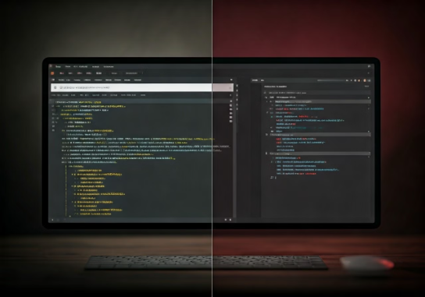
Pushing a Folder to GitHub: Visual Guide
VS Code Steps
GitHub Steps
Open your VS Code project folder.
Log in to your GitHub account.
Click the "Source Control" icon in the left sidebar.
Create a new repository.
Copy the repository URL.
Click the "New Branch" icon.
Open your VS Code project folder.
Type a branch name and click "Create Branch".
Click the "Source Control" icon.
Click the three dots icon and select "Push to GitHub".
Make your changes to files.
Click the "Source Control" icon again.
Paste the repository URL into the "Remote" field.
Enter a commit message in the text box.
Click "Commit" to save your changes.
Click "Push" to upload changes to GitHub.
Click the "Source Control" icon again.
Click the three dots icon and select "Push to GitHub".
Click "Push" to upload changes to GitHub.

Slide 14
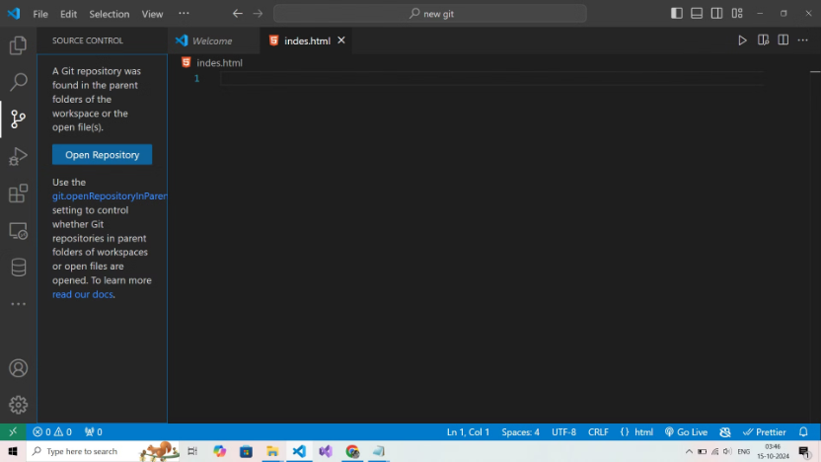
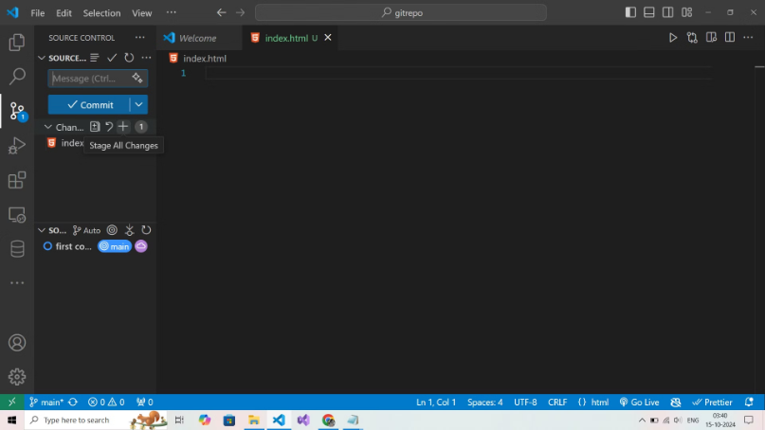
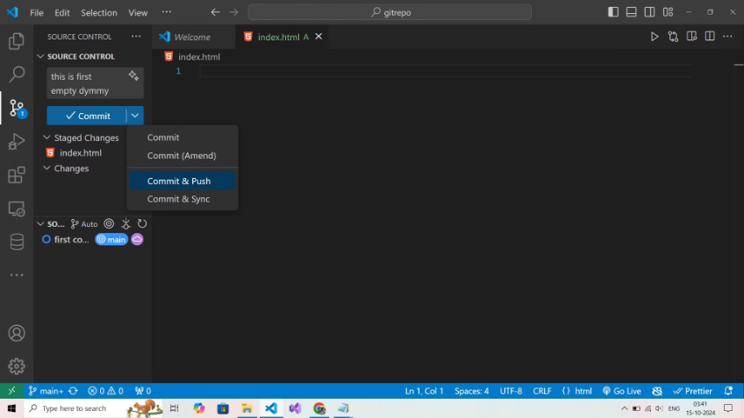
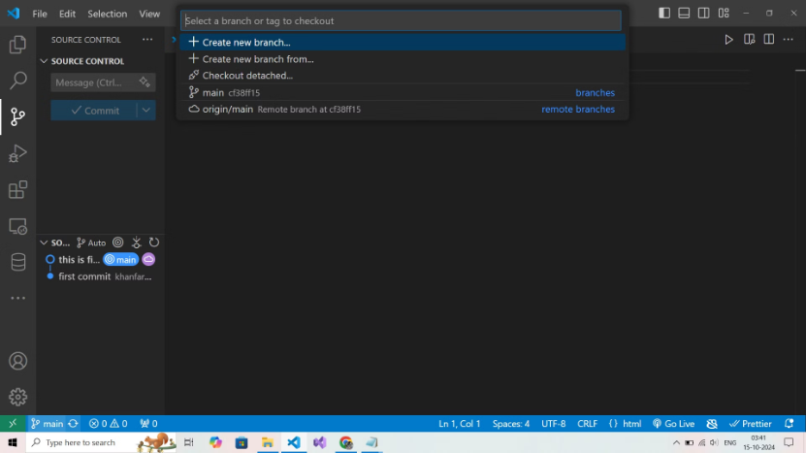
1. Create Repo in vs code
2. Stage All change :-
3. How to commit in vs code :-
4. How to Create Branch in vs code :-

